Slide 1




Summary
Total male employees are 343 and the females are 342
Total department are 6
Our Goal?
We have total 52 factors which help in gaining a good evaluation score but not all the factors are playing major roles to have a good evaluation score which shows the performance of an employee. In our analysis we will see which factors are playing the most important role and considering them we will try to find out the result. Also we will predict the evaluation score for the new employees in the organization.
Total number of jobs 7
Notes:
We have total 685 employees out of which 343 are male and 342 are females. The total department in the organization is 6 and the number of job roles are 7.

Slide 2
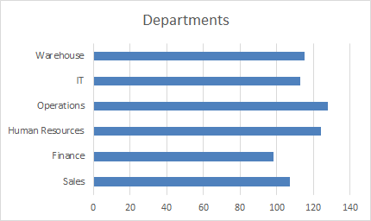
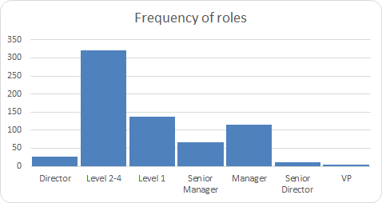
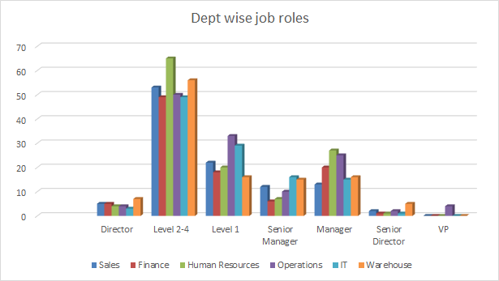
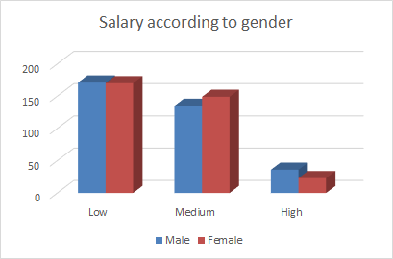
Analysis
Most of the people are working as level 2-4 employees in the organization and the number of Vice presidents are very few.
Majority of people are working for Operations and the employees in finance are less compared to the other departments
Number of females are more for medium package and for high package the ratio of males are more compared to the females
Human resource has the highest number of level 2-4 employees
Notes:
This is the visualization of the data which elaborates employees, roles, salary (gender wise) and the department they are working in.

Slide 3



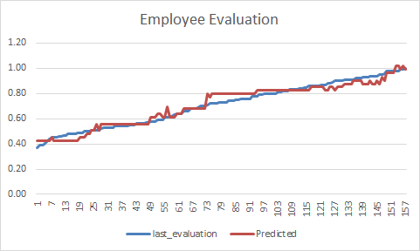


Significant values
The data shows that the average evaluation score of an employee is 72.50 and 63% of the total employees are working remotely.
Each employee has spent monthly 200 hours to do their tasks in the company .
The total number of work accidents that took place while working is 74.
The total number of projects that are done is 1972.
Name | Values
Average employee evaluation score | 72.50
Employees working remotely | 63%
Total number of projects | 1972
Work accidents | 74
Average monthly hours an employee works | 200 hours
Prediction of employee evaluation using our predictive model. Higher score of the evaluation implies better performance.
This Photo by Unknown Author is licensed under CC BY-NC
Notes:
Some significant results which we have found from our analysis. And we can see employees are tend to work remotely compared to on premise. The charts shows the result of the original and the predicted value of evaluation score by the supervisor which shows their performance level

Slide 4



Results
Employee engagement on their company activities plays a vital role to enhance good evaluation score by the supervisor. However employee role also plays an important role on the score but it is not as impactful as employee engagement.
People who are working remotely are happy and tend to work better than the people who are working on premise.
Along with these two factors employee satisfaction also matters a lot, if the employee is not happy will effect on their job performance. Our statictial model and analysis shows employees who are more satisfied with the company and also with their job are performing quite better which increases their performance level.
Satisfied work from home?
Satisfied with the job?
Engaged in company activity?
Notes:
The performance of the employee is effected by the employee satisfaction on their jobs and their engagement with the company activities extensively. However, who are working from home seem to be more satisfied and happy with the company and also with their work.

Slide 5



Conclusion
If an employee is working from home and they are happy with their work that’s a good sign for the employee.
Employee satisfaction and engagement matters a lot to achieve a higher performance level. Of course if the employee is not happy then he/she will fail to give their 100% in their jobs which will impact on their performance.
Notes:
Higher is the engagement and the satisfaction level better will be the performance.

